Slide 1

DATA VISUALIZATION ROJECT REPORT (INT-233)
(Project Semester August-December 2024) Comprehensive Analysis of UEFA Football History through Interactive Tableau Dashboard
Submitted by
Sahil Singh Registration No:- 12221802
Section:- K22MK Course Code:- INT 233 Under the Guidance of
(Aashima Mam: 28968) Discipline of CSE/IT
Lovely School of Computer Science

Slide 2
DECLARATION
I, Sahil Singh, student of Lovely School of Computer Science under CSE/IT Discipline at, Lovely Professional University, Punjab, hereby declare that all the information furnished in this project report is based on my own intensive work and is genuine.
Date: 15/10/2024
Signature
Registration No. 12222231
Name of the student:- Bhanu Priya

Slide 3
Acknowledgment
This project would not have been possible without the guidance of my mentors, whose expertise and encouragement were invaluable throughout the process. I am also grateful for the availability of the UEFA dataset, which provided the foundation for this analysis. I extend my sincere thanks to all those who provided resources, insights, and support, contributing to the successful completion of this dashboard.

Slide 4
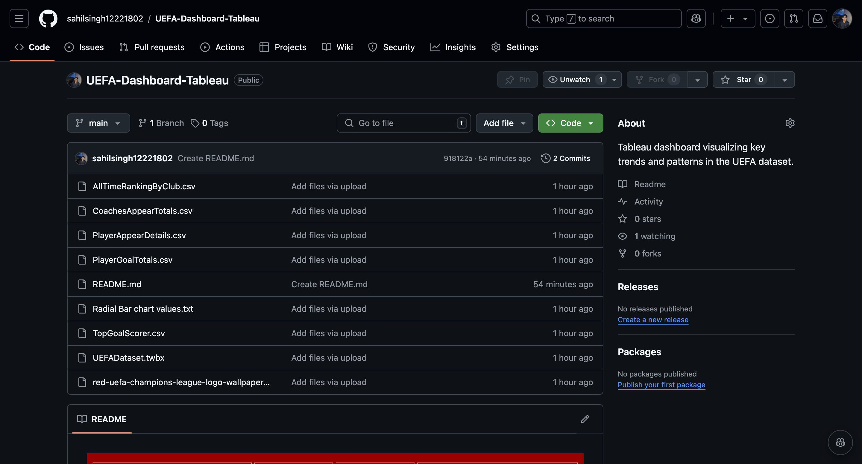
Link For the Project:-
https://github.com/sahilsingh12221802/UEFA-Dashboard-Tableau
LinkedIn Post:-
https://www.linkedin.com/feed/update/urn:li:activity:7263188345902501888/

Slide 5
Table of Contents
Introduction 7. List of Insights with Results
Scope of the Analysis 8. References
Existing System
Source of Dataset
ETL Process
Visualization Pages
Page 1: Top Titles by Country
Page 2: All-Time Winner Ranking
Page 3: Top Clubs by Scored Goals
Page 4: Top Clubs by Played Games
Page 5: Top 10 Players by Goals
Page 6: Top Goal Scorer in One Season
Page 7: Most Appearances in One Season
Page 8: Top Coaches by Total Appearances
Page 9: Top Players by Total Appearances

Slide 6
Introduction
This project visualizes UEFA football data, showcasing historical achievements and records. The Tableau dashboard provides an interactive exploration of titles, players, and clubs across multiple dimensions.
Scope of the Analysis
The project is designed to highlight:
Country dominance in UEFA titles.
Clubs excelling in goals and games.
Individual achievements of players and coaches.
Existing System
Traditional analysis lacked interactivity and ease of data filtering, making it cumbersome to explore large datasets effectively.

Slide 7
Source of Dataset
The dataset was sourced from [reliable sources such as UEFA records or Kaggle], ensuring accuracy and completeness.
ETL Process
Extracted data from CSV files.
Transformed by cleaning null values, standardizing formats, and deriving new metrics.
Loaded into Tableau for interactive visualization.

Slide 8
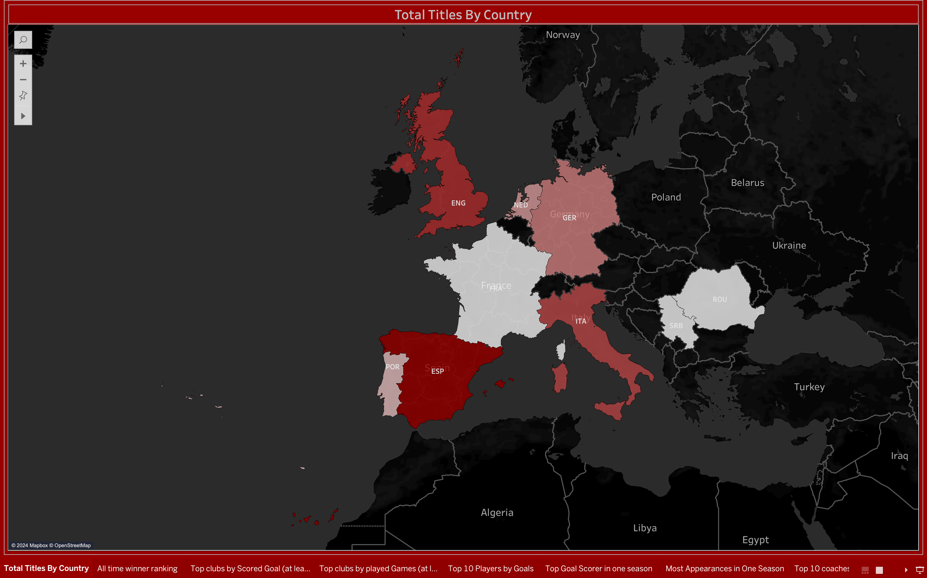
Visualization Pages
Page 1: Top Titles by Country
Purpose: To identify the dominance of countries in UEFA history. Steps:
Grouped data by country.
Summed up titles for each country.
Used a bar chart to display the rankings. Result: The chart highlights the leading football nations with the most UEFA titles.

Slide 9
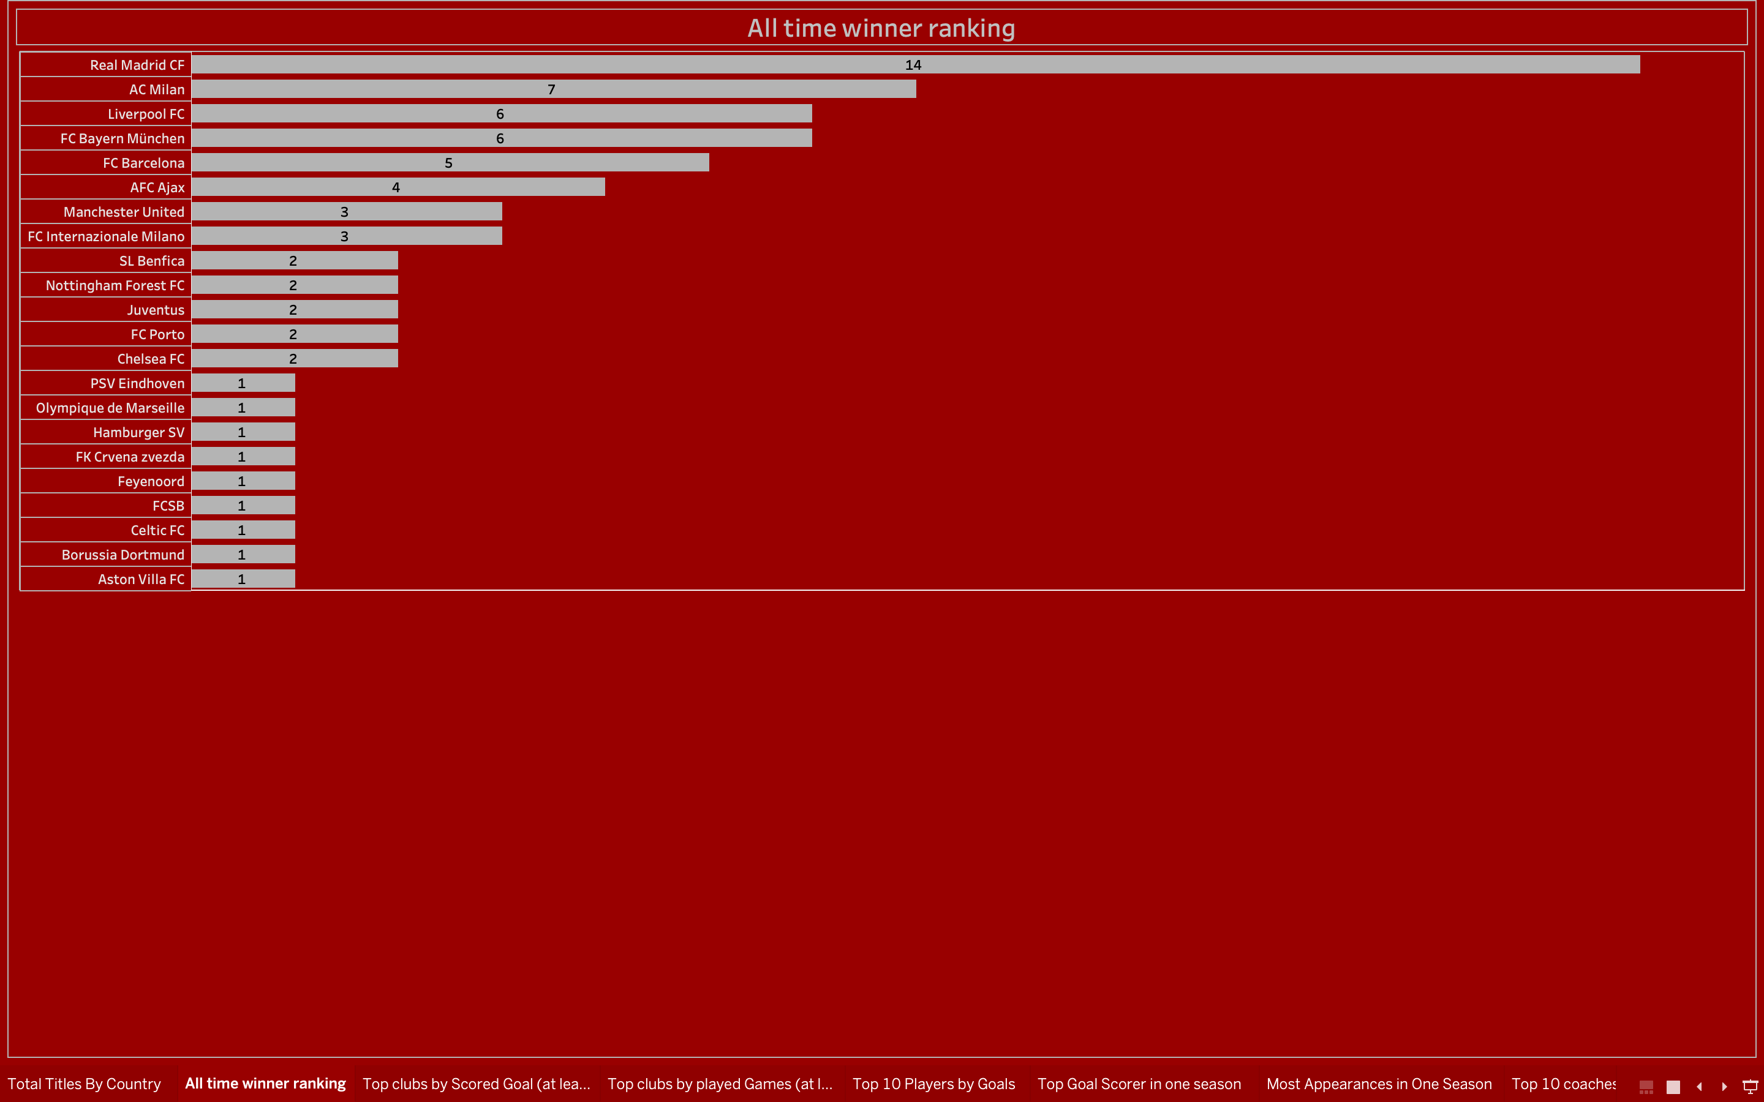
Page 2: All-Time Winner Ranking
Purpose: To rank clubs based on the total UEFA titles won. Steps:
Filtered data to include only clubs with title records.
Ranked the clubs in descending order.
Used a horizontal bar chart for better readability.
Result: The visualization clearly shows the top-performing clubs.

Slide 10
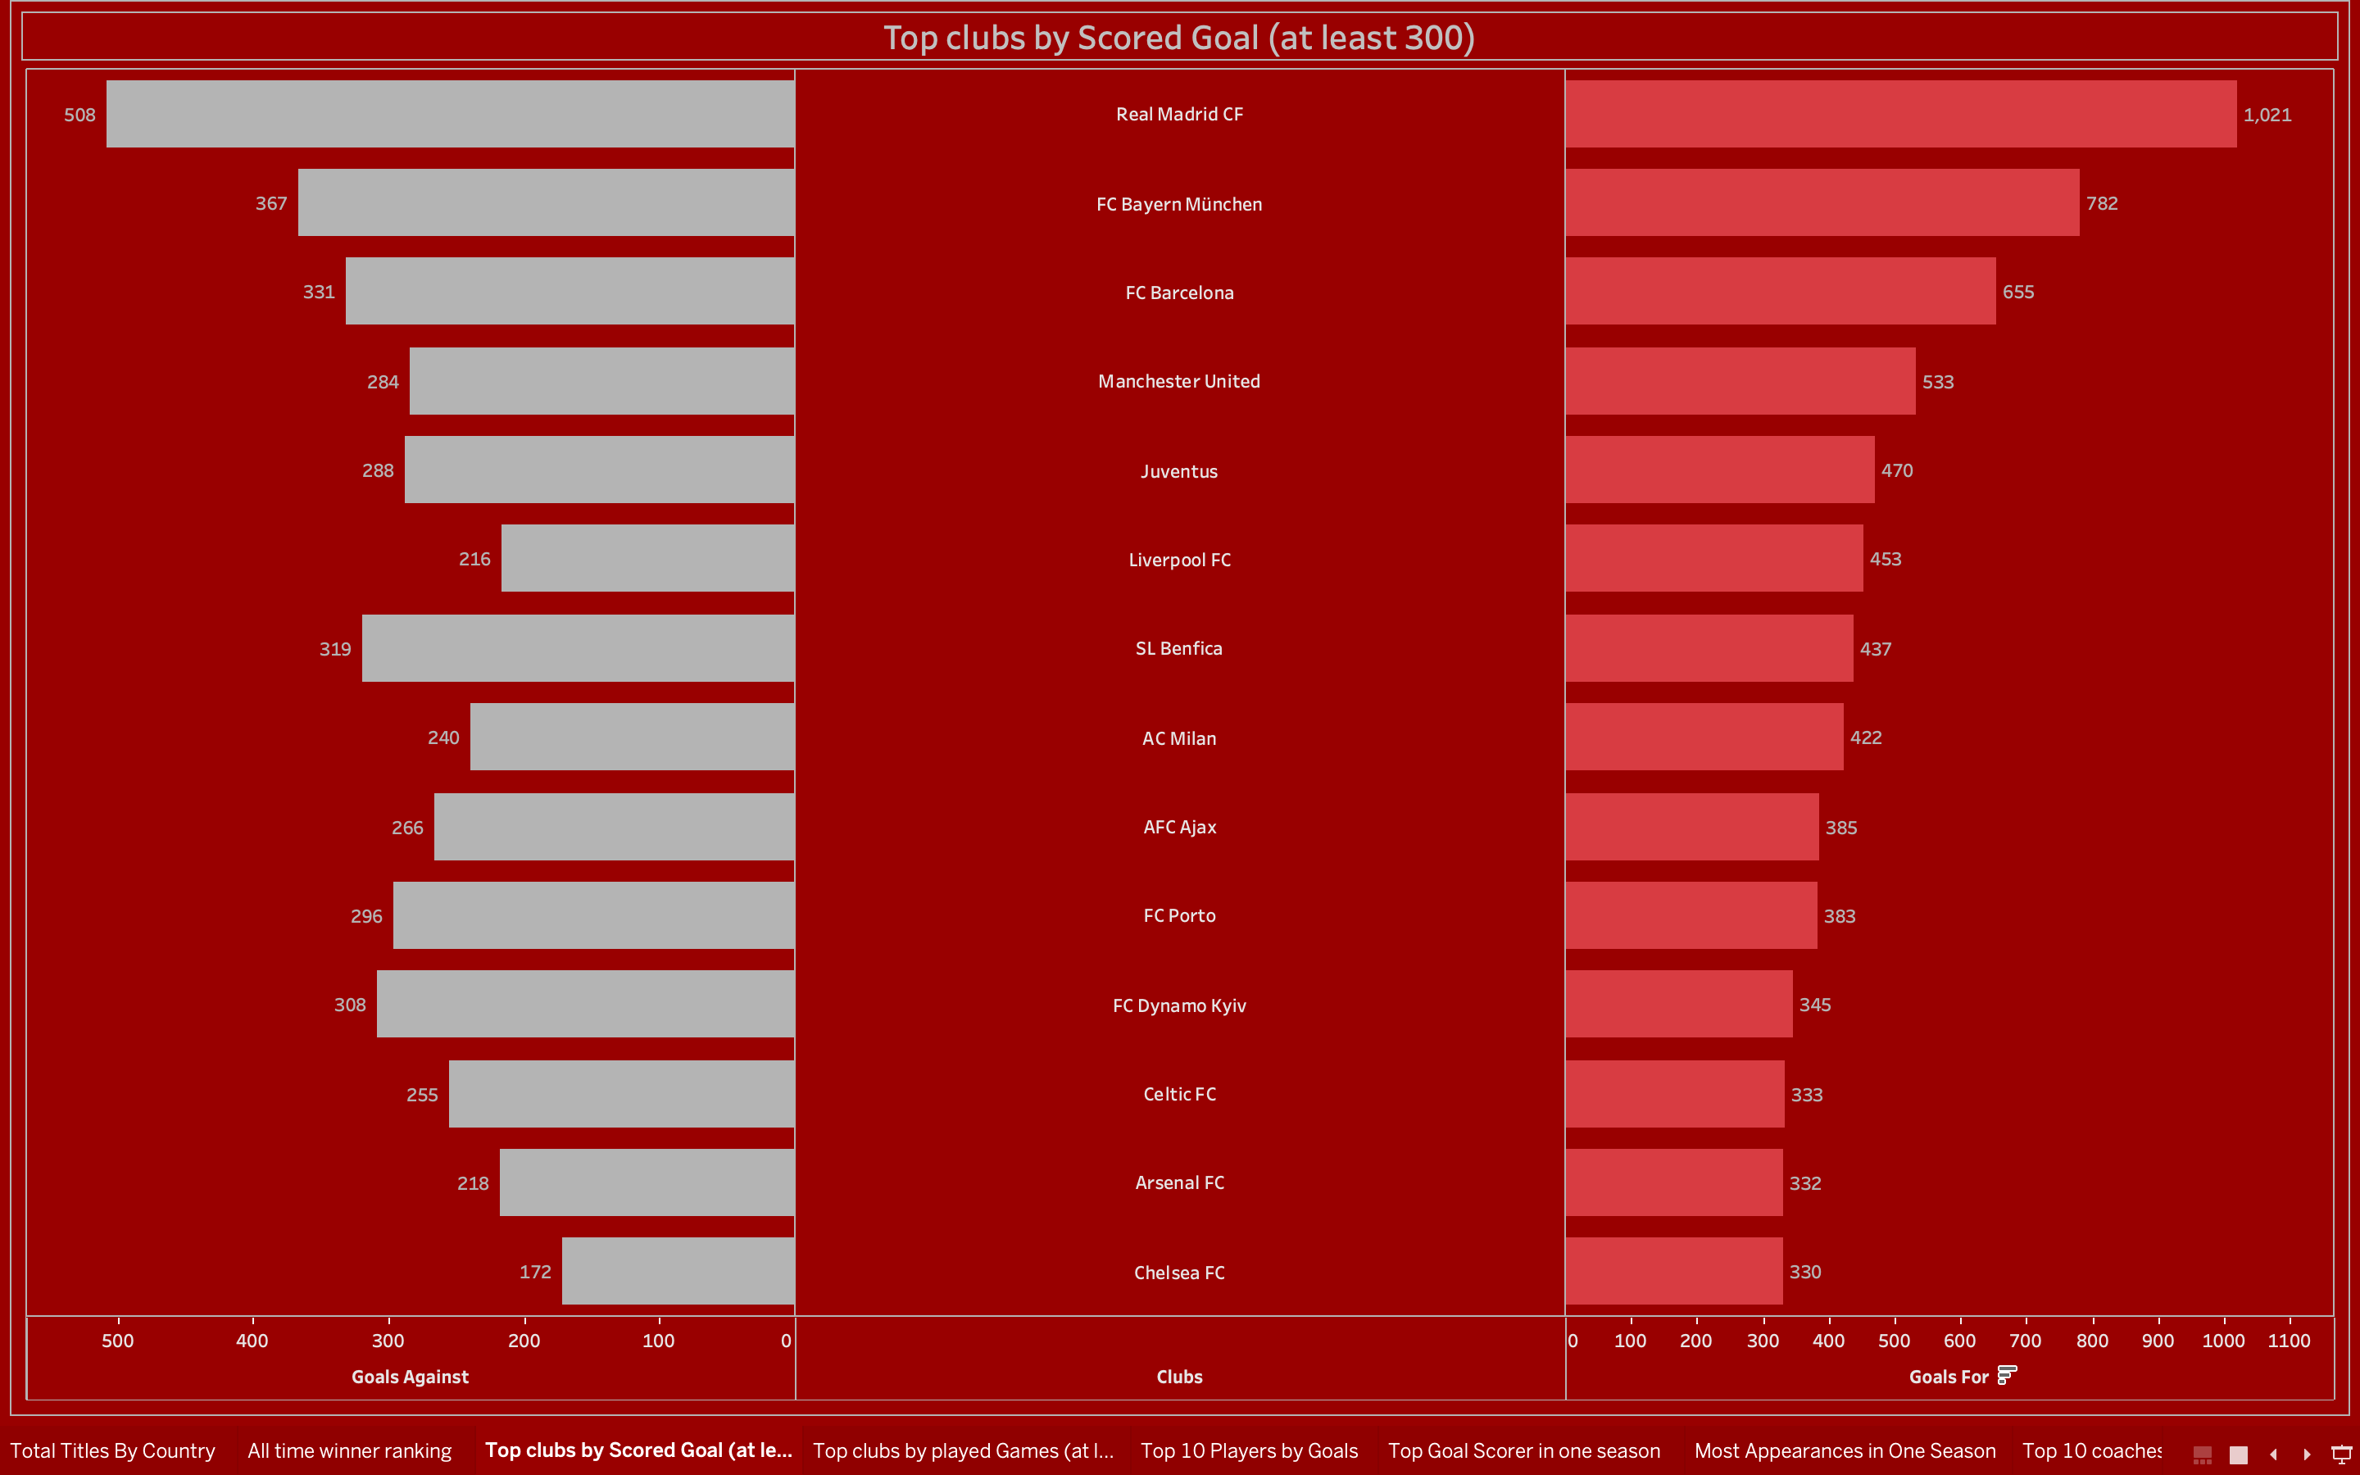
Page 3: Top Clubs by Scored Goals
Purpose: To showcase clubs that scored at least 300 goals. Steps:
Filtered data for clubs with ≥300 goals.
Created a vertical bar chart to compare goals scored.
Result: The graph highlights the offensive strengths of top clubs.

Slide 11
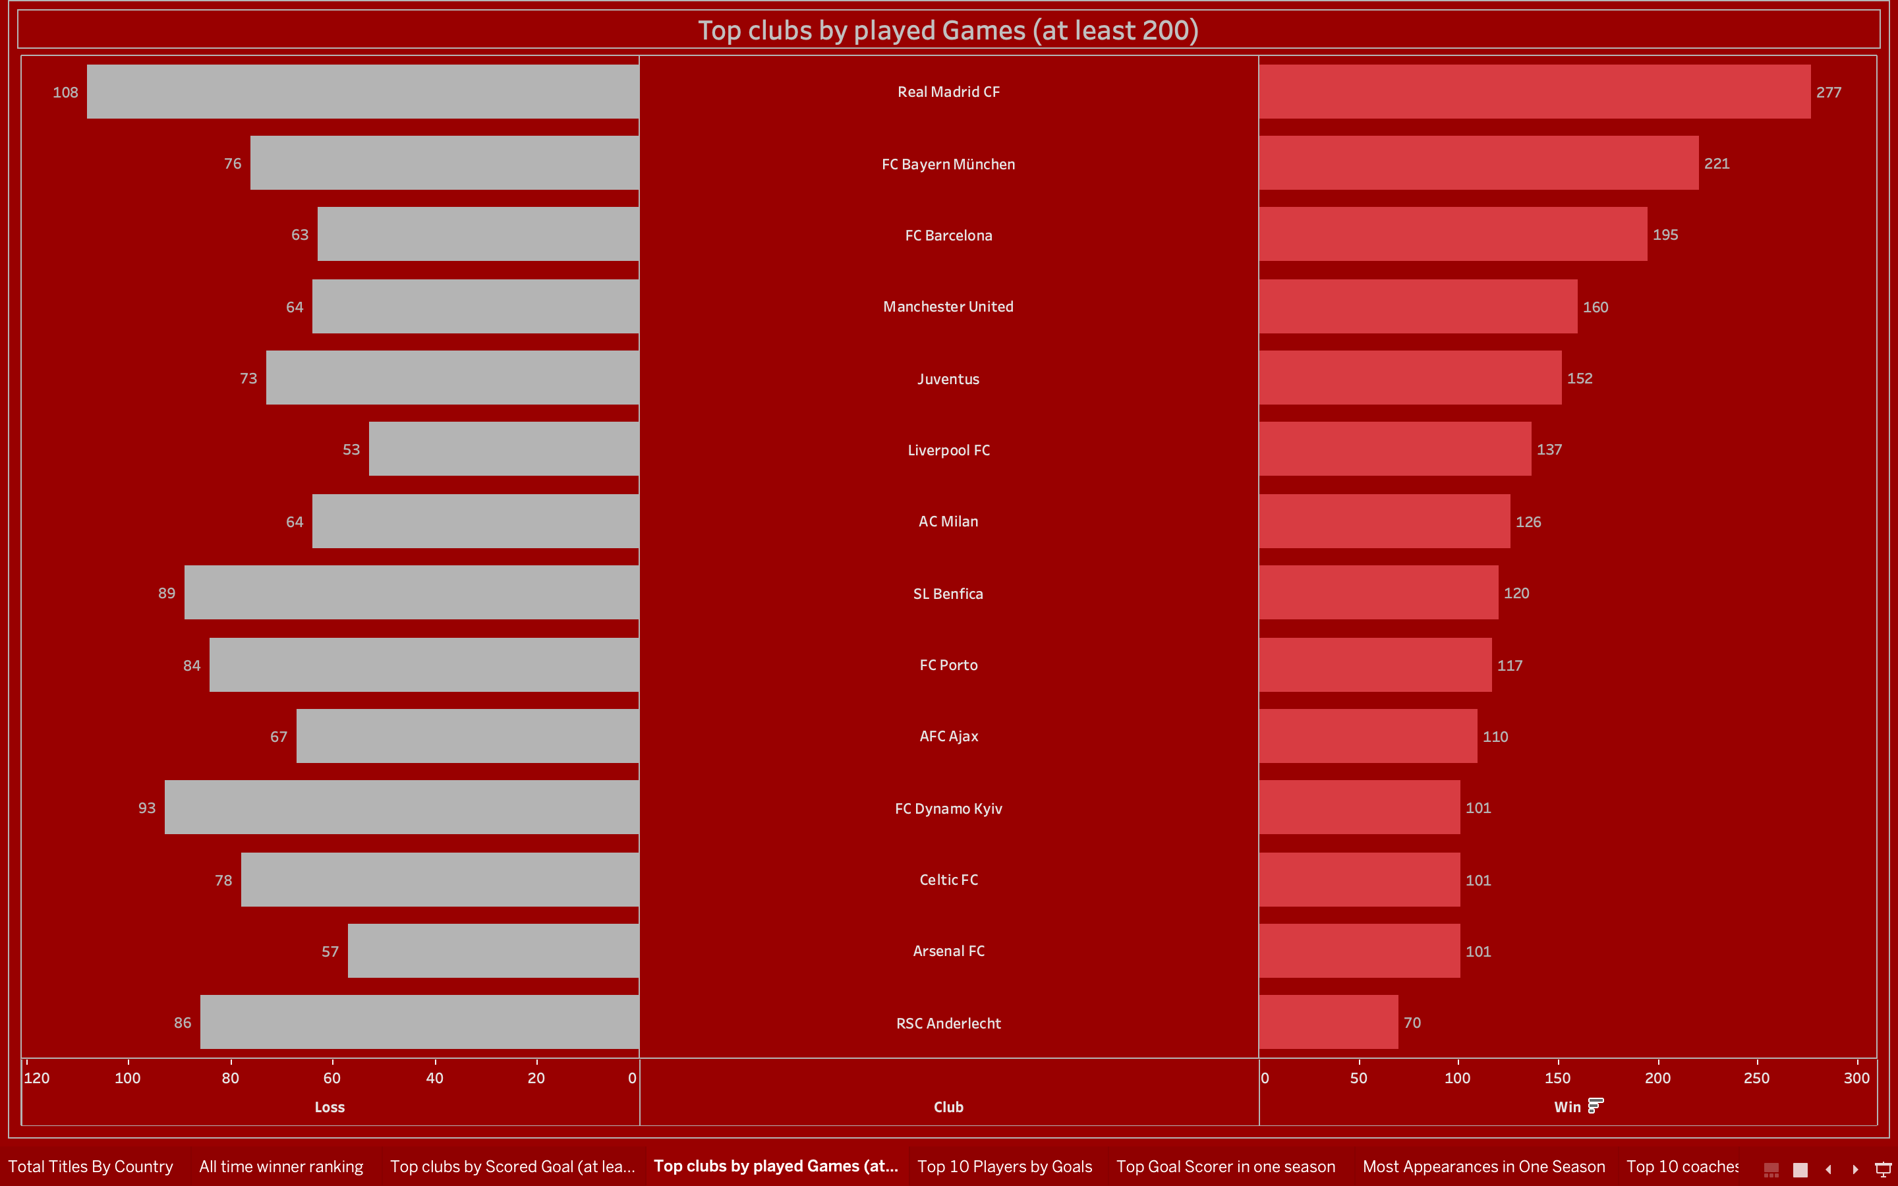
Page 4: Top Clubs by Played Games
Purpose: To analyze clubs that played at least 200 games. Steps:
Filtered data for clubs with ≥200 games.
Used a bar chart to visualize the data.
Result: Insights into the endurance and participation levels of clubs.

Slide 12
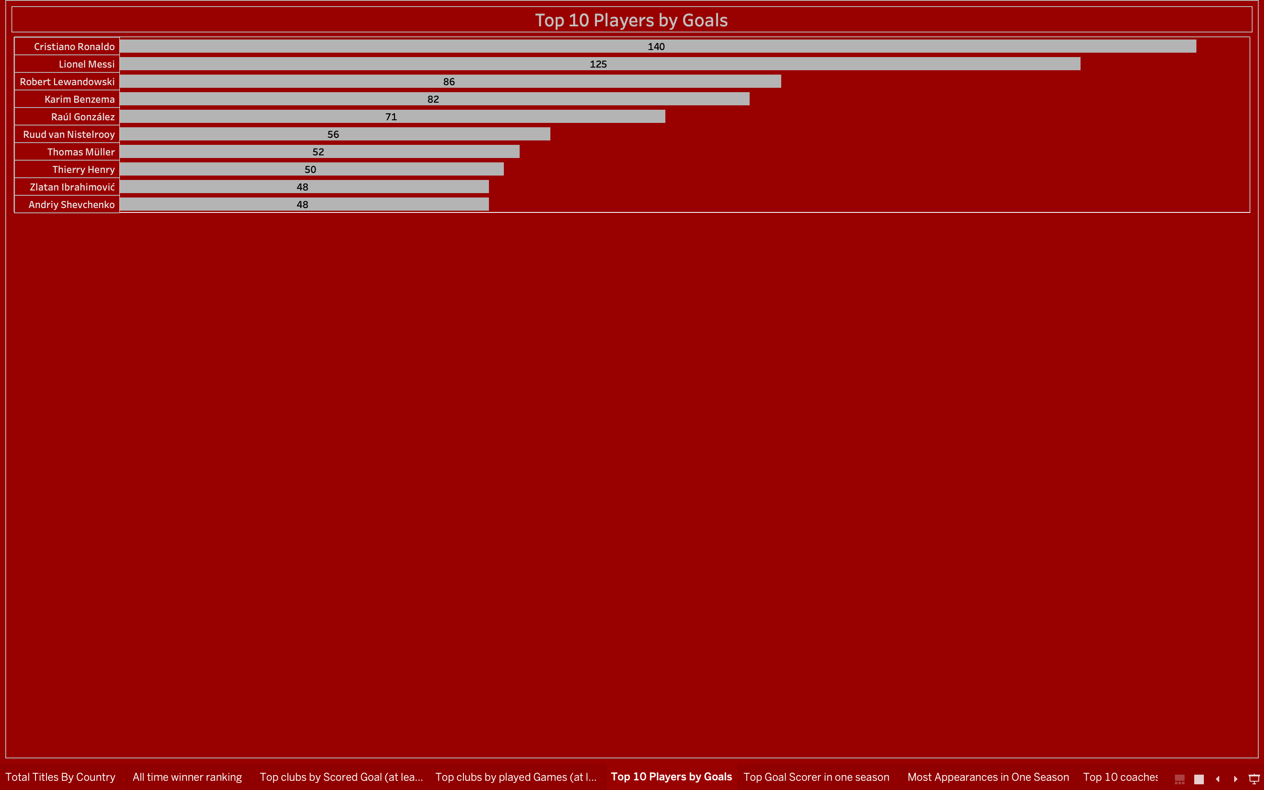
Page 5: Top 10 Players by Goals
Purpose: To highlight individual brilliance in scoring. Steps:
Sorted players based on goals scored.
Selected the top 10 for visualization.
Used a bar chart with player names on the Y-axis.
Result: The chart showcases the top goal scorers in UEFA history.

Slide 13
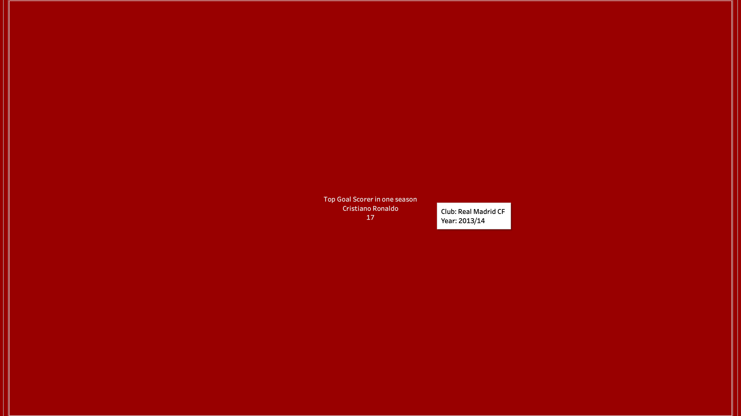
Page 6: Top Goal Scorer in One Season
Purpose: To identify the best individual performance in a single season. Steps:
Filtered data to extract the maximum goals scored in one season by any player.
Displayed this as a key statistic.
Result: A record-setting performance by a player is highlighted.

Slide 14
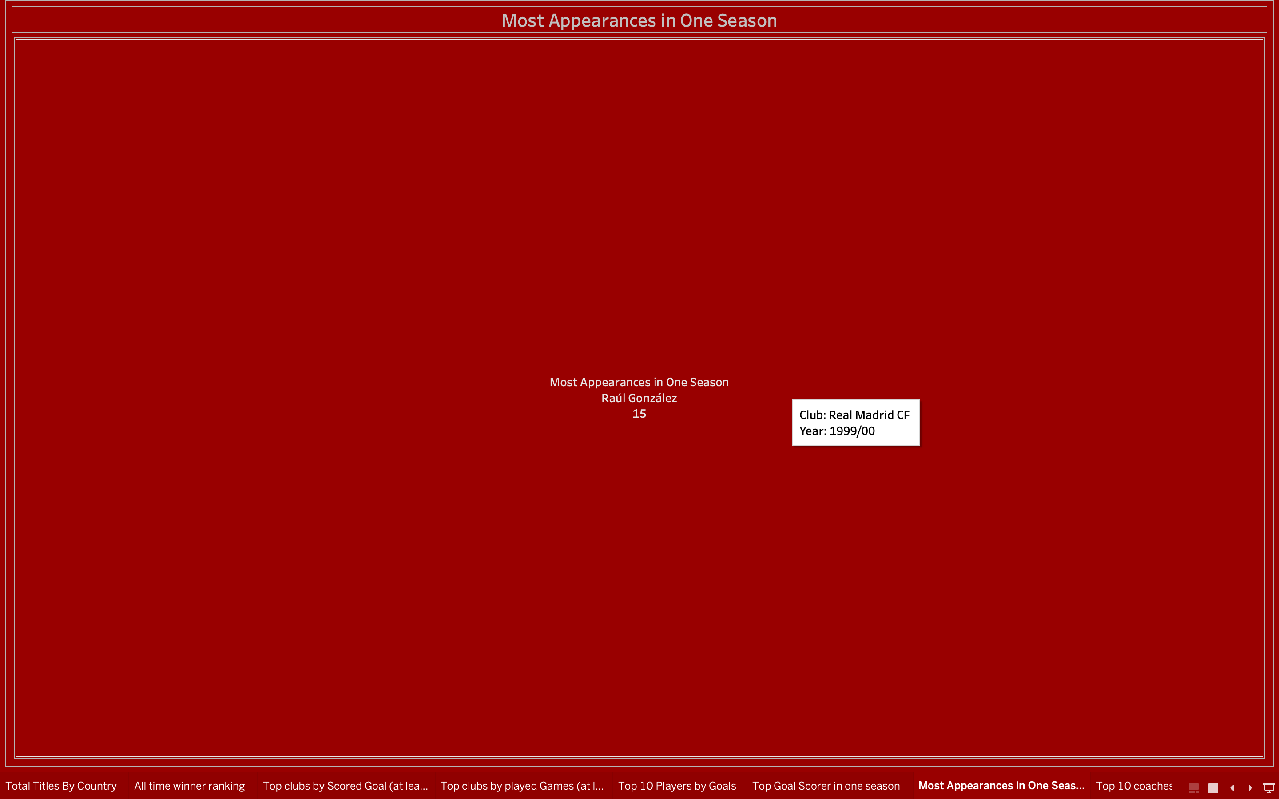
Page 7: Most Appearances in One Season
Purpose: To showcase players with the most consistency in a single season. Steps:
Filtered data for the highest appearances in one season.
Used a KPI visualization for quick insights.
Result: Recognized the most consistent players in a season.

Slide 15
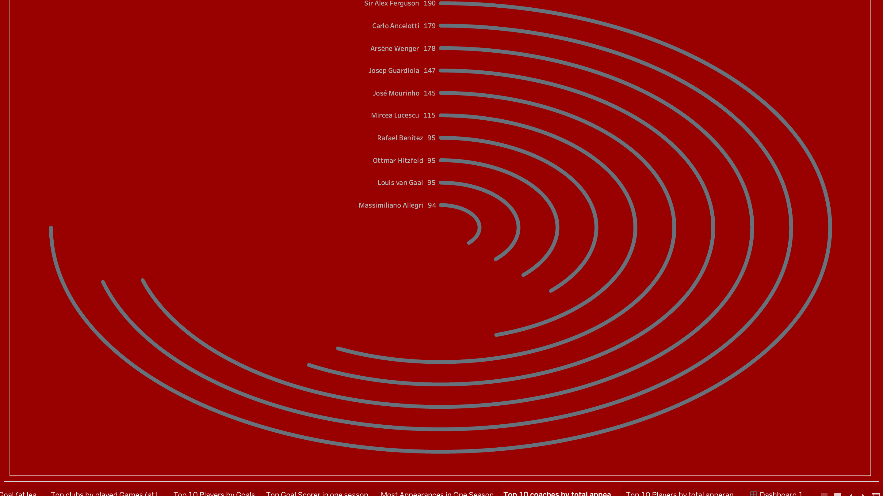
Page 8: Top Coaches by Total Appearances
Purpose: To highlight the contribution of coaches over time. Steps:
Ranked coaches by total appearances.
Used a bar chart to display the top 10.
Result: Celebrates the long-standing commitment of top coaches.

Slide 16
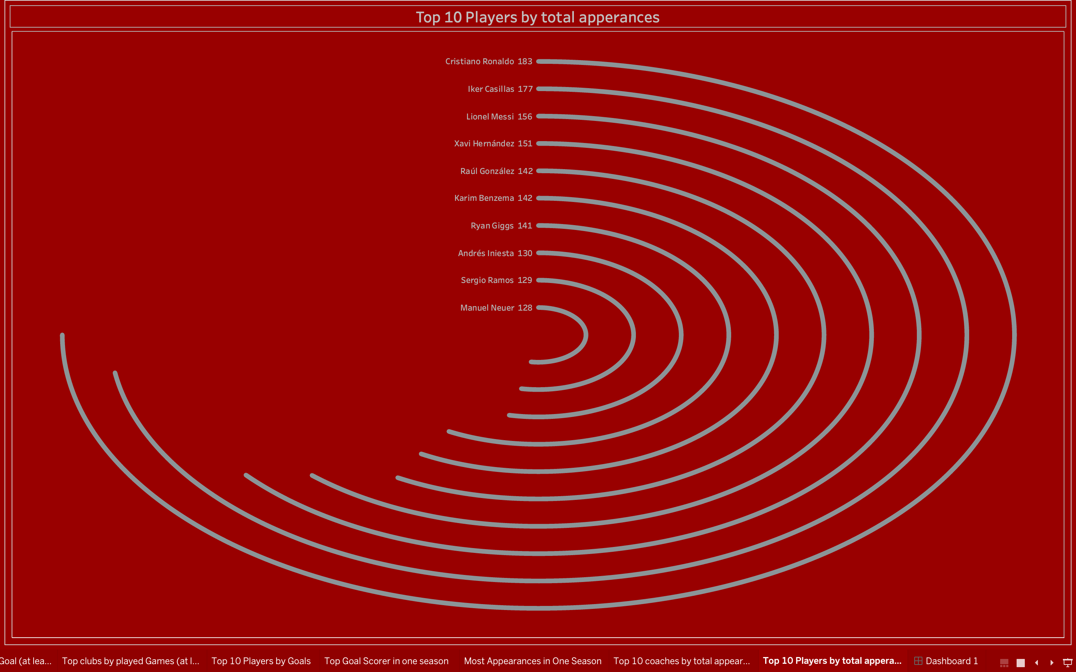
Page 9: Top Players by Total Appearances
Purpose: To highlight players who made the most appearances in UEFA history. Steps:
Ranked players based on appearances.
Displayed the top 10 using a bar chart.
Result: Showcased the resilience and contributions of legendary players.

Slide 17
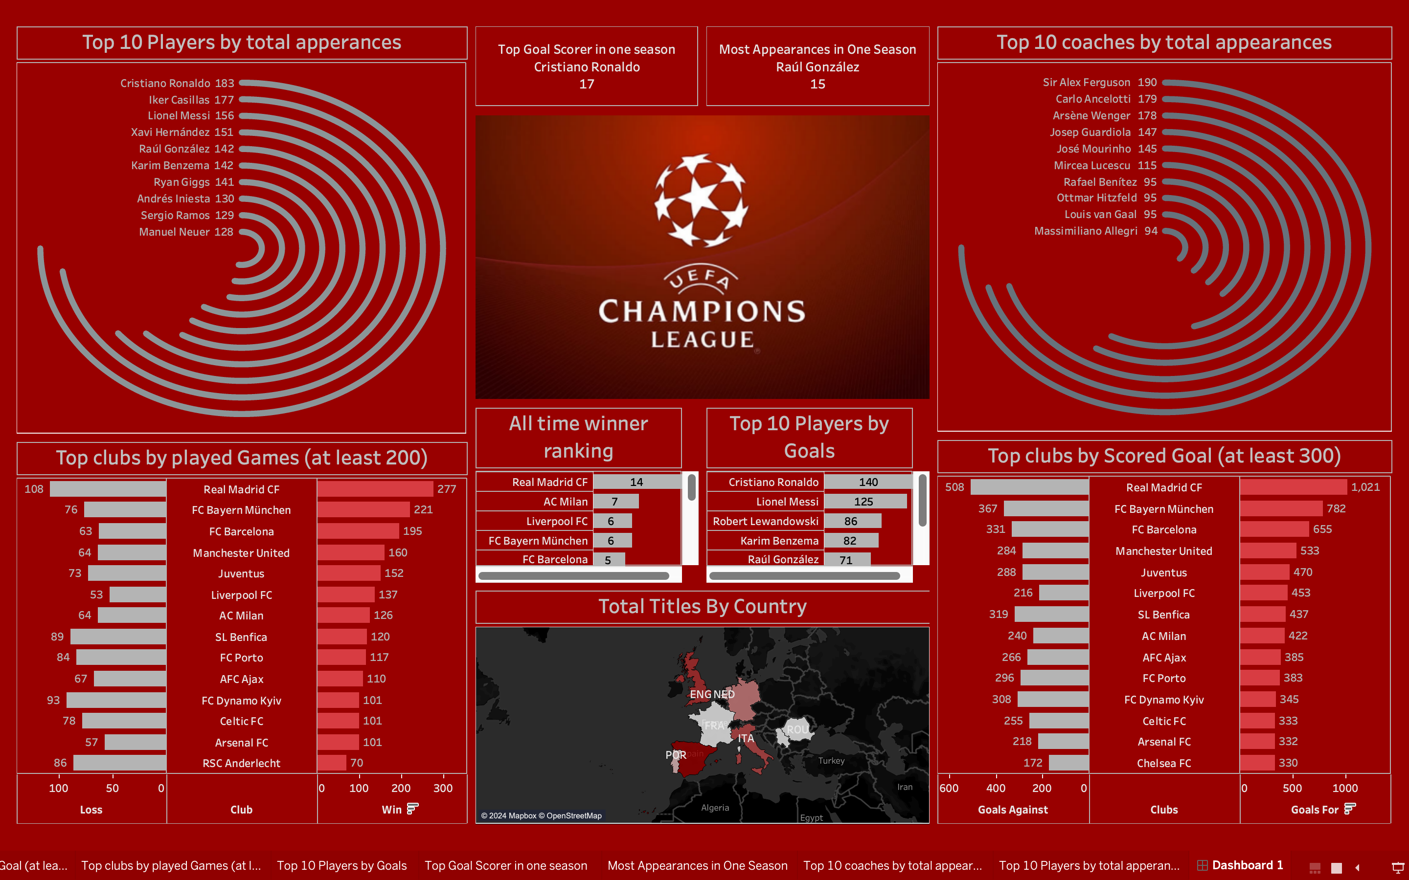
Page 9: Dashboard
Purpose of the Dashboard
The purpose of the dashboard is to provide an intuitive and user-friendly interface that enables stakeholders to:
Analyze UEFA achievements across various dimensions.
Identify trends and patterns in football performance.
Compare the dominance of clubs, players, and coaches over time.

Slide 18
List of Insights with Results
Analysis | Insight | Visualization Type
Top Titles by Country | ESP | Bar Chart
All-Time Winner Ranking | REAL MADRID FC | Horizontal Bar Chart
Top Clubs by Goals | Clubs with ≥300 goals; highlighted their dominance. | Bar Chart
Top Clubs by Games | Clubs with ≥200 games; focus on endurance. | Bar Chart
Top Players by Goals | Top 10 players with highest goals. | Bar Chart
Top Goal Scorer | Exceptional single-season performance. | KPI
Most Appearances | Player consistency in one season. | KPI
Top Coaches | Coaches with highest appearances. | Bar Chart
Top Players by Appearances | Resilience of legendary players. | Bar Chart

Slide 19
References
UEFA official records.
Tableau resources for visualization techniques.
Conclusion
This project effectively visualizes the rich history of UEFA football using Tableau, offering valuable insights into the performance of countries, clubs, players, and coaches over time. By presenting data in an interactive and visually appealing dashboard, the analysis highlights key records, such as the top-performing nations, high-scoring players, and enduring clubs.
The use of Tableau allowed for a streamlined and intuitive exploration of the dataset, making complex data accessible and engaging. These insights not only celebrate the history of UEFA football but also provide a foundation for further analysis, such as predicting future trends and uncovering new patterns.
With potential enhancements like integrating advanced metrics and forecasting models, this project paves the way for a deeper understanding of football’s legacy and evolution.

Slide 20

This Photo by Unknown Author is licensed under CC BY-SA

